Slide 1
Bill Inmon Vs. Ralph Kimball Approach

Slide 2
Bill Inmon’s Approach
Known as top-down approach
Data Warehouse is created first. In the data warehouse, information is stored in 3rd normal form.
Then after this the Data Marts are created.

Slide 3
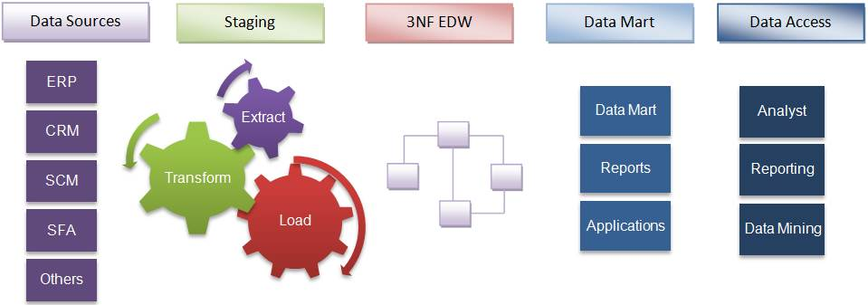
Bill Inmon’s Approach

Slide 4
Ralph Kimball’s Approach
Known as bottom-up approach
Data Marts are created first.
Then data marts are combined to make broad database.

Slide 5
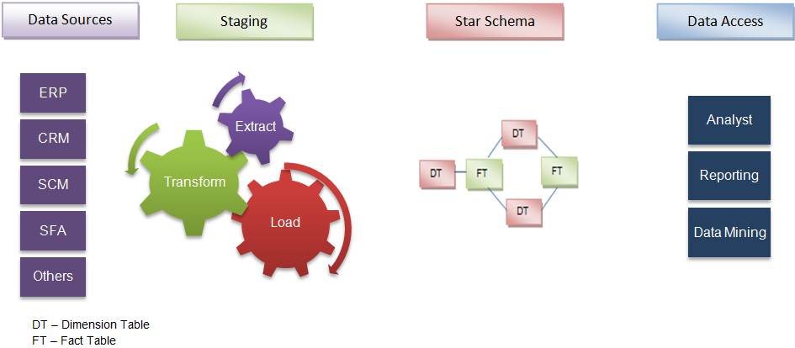
Ralph Kimball’s Approach

Slide 6
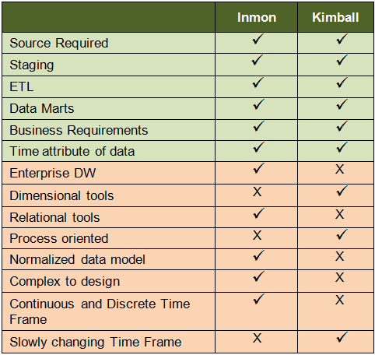
Comparison

Slide 7
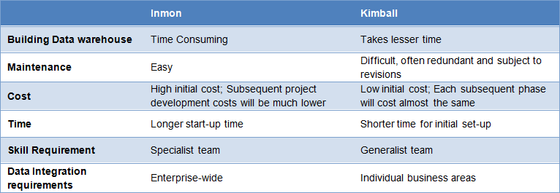
Pros and cons of both the approaches

Slide 8
When to select which approach??
Inmon’s approach is suitable for stable businesses which can afford the time taken for design and the cost involved. Also, with every changing business condition, they do not change the design; instead they accommodate these into the existing model.
However, if local optimization is good enough and the focus is on quick win, it is advisable to go for Kimball’s approach.

Slide 9
Different Scenarios – Slide 1
Insurance: It is vital to get the overall picture with respect to individual clients, groups, history of claims, mortality rate tendencies, demography, profitability of each plan and agents, etc. All aspects are inter-related and therefore suited for the Inmon’s approach.
Marketing: This is a specialized division, which does not call for enterprise warehouse. Only data marts are required. Hence, Kimball’s approach is suitable.

Slide 10
Different Scenarios – Slide 2
Manufacturing: Multiple functions are involved here, for creating the budget. Thus, where there is a systemic dependency as in this case, an enterprise model is required. Hence Inmon’s approach is ideal.
CRM in banks: The focus is on parameters such as products sold, up-sell and cross-sell at a customer-level. It is not necessary to get an overall picture of the business. For example, there is no need to link a customer’s details to the treasury department dealing with forex transactions and regulations. Since the scope is limited, you can go for Kimball’s approach.

